Slide 1
Travelogy
OPIM 5272 - Project Presentation
12/06/2023
Group 2 Riya Choudhary, Rohit Kamineni
Page 1
Notes:
Entered text
Solution
Implement a robust database system that consolidates all services and maintains a record of customer behaviors. This system also takes feedback for the bookings.
At a high level, the database for the new structure would have all service providers under one roof, which the customer will not interact with. The customer information and feedback are taken as input from the users through efficiently placed prompts.
Entered text
Summary of Benefits
The new and improved solution provides:
• No need for any redirects to vendor platforms. All services are accessible from one unified platform
• Customer access to multiple services in a single transaction.
• Improved customer experience with personalized recommendations
• Enhanced operational efficiency.
• Improved customer experience with the help of feedback.
• Data-driven insights for better decision-making.
Entered text
Summary of Benefits
The new and improved solution provides:
• No need for any redirects to vendor platforms. All services are accessible from one unified platform
• Customer access to multiple services in a single transaction.
• Enhanced operational efficiency.
• Improved customer experience with the help of feedback.
• Data-driven insights for better decision-making.

Slide 2

Story of Travelogy
Travelogy wasn't just another online travel agency; it was a visionary platform. It seamlessly integrated everything from flight bookings, train reservations, car rentals, to hotel accommodations and travel insurance, all under one virtual roof.
It was born out of a desire to simplify travel planning. The idea was to give travelers a one-stop solution, making their trip planning effortless and enjoyable.
Page 2

Slide 3

Problems…!
With increasing competition and evolving customer expectations, the company is facing:
Customers must interact with each vendor individually in separate transactions.
Inefficiencies in managing vendor commissions.
Challenges in tracking customer preferences
Lack of personalized travel recommendations
Page 3

Slide 4
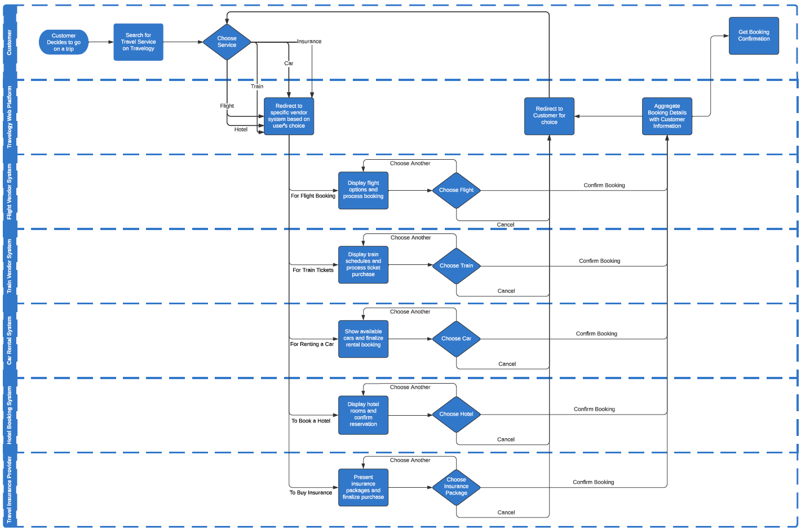
AS-IS Model
Page 4

Slide 5
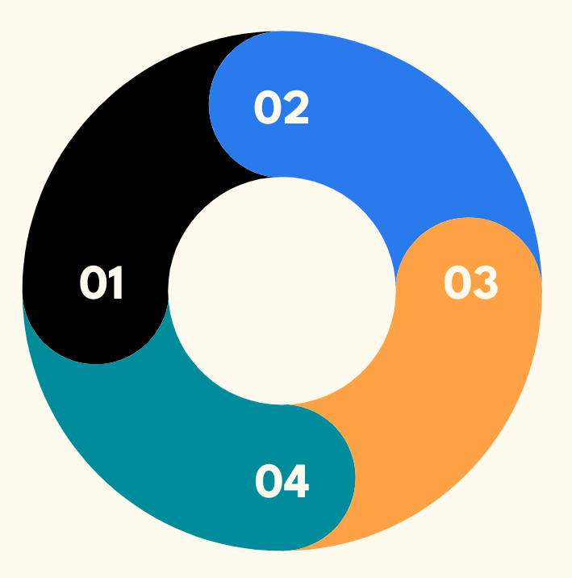
Travelogy Re-imagined
Unified Platform with access to all service providers under one roof
New robust database system
Taking feedback for the bookings
Consolidating all services
Page 5

Slide 6
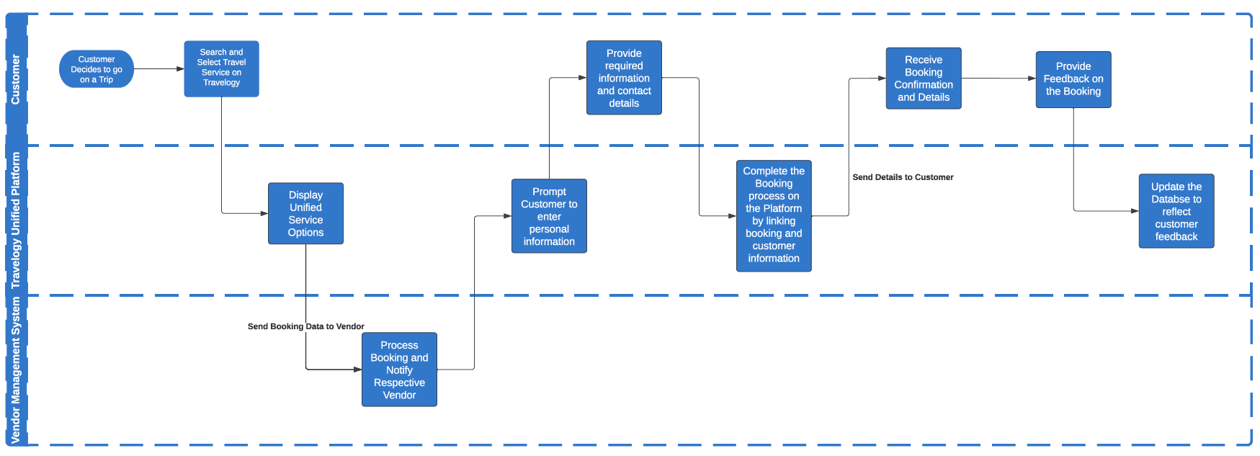
TO-BE Model
Streamlined
Reduced Complexity with lower number of Actors
Page 6

Slide 7
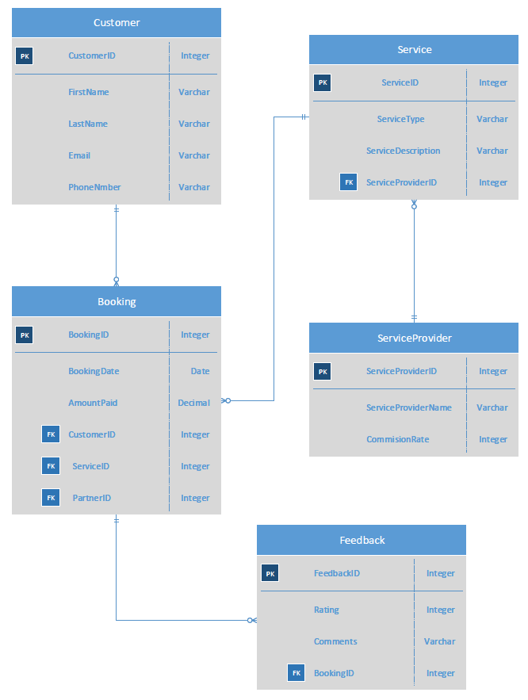
Data Model & ERD
Normalized
Clarity
Scalable
Referential Integrity
Flexibility
Page 7
Notes:
Normalization: The data model appears to be normalized, reducing redundancy and improving data integrity.
Clarity: The ERD is clear and well-structured, with easily identifiable relationships between entities.
Scalability: It is designed to easily accommodate more data over time without requiring significant changes to the structure.
Referential Integrity: The use of foreign keys ensures referential integrity, linking related data across different tables effectively.
Flexibility: The model allows for multiple services per booking and can capture feedback for each booking, offering comprehensive data capture.

Slide 8

Report 1: High-Value Customers
-- 1.High-Value Customers
SELECT c.CustomerID, c.FirstName, c.LastName, SUM(b.AmountPaid) AS TotalAmountSpent
FROM Customer c
JOIN Booking b ON c.CustomerID = b.CustomerID
GROUP BY c.CustomerID, c.FirstName, c.LastName
HAVING SUM(b.AmountPaid) > 1500;
Lists customers who have spent over $1500, highlighting their total expenditure.
Identifies the most valuable customers
Key for customer segmentation, relationship management, and revenue forecasting.
Page 8
Notes:
Report: High-Value Customers
● Description: Lists customers who have spent over $1500, highlighting their total expenditure.
● Business Purpose & Benefit: Identifies the most valuable customers, enabling targeted marketing and personalized service offers.
● Use in Business Metric: Key for customer segmentation, relationship management, and revenue forecasting.

Slide 9
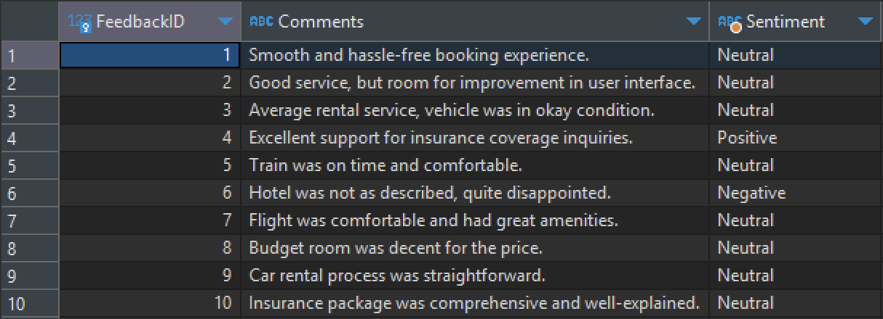
Report 2: Feedback Analysis
-- 4. Feedback Analysis
SELECT f.FeedbackID, f.Comments,
CASE
WHEN f.Comments LIKE '%xcellent%' OR f.Comments LIKE '%outstanding%' OR f.Comments LIKE '%awesome%' THEN 'Positive'
WHEN f.Comments LIKE '%poor%' OR f.Comments LIKE '%bad%' OR f.Comments LIKE '%horrible%' OR f.Comments LIKE '%disappointed%' THEN 'Negative'
ELSE 'Neutral'
END AS Sentiment
FROM Feedback f
JOIN Booking b ON f.BookingID = b.BookingID;
Analyzes feedback comments for sentiment
Provides insights into customer satisfaction
Key for quality assurance and service development
Page 9
Notes:
Report: Feedback Analysis
● Description: Analyzes feedback comments for sentiment based on the presence of specific keywords.
● Business Purpose & Benefit: Provides insights into customer satisfaction and areas for service improvement.
● Use in Business Metric: Important for quality assurance, service development, and maintaining high customer satisfaction.

Slide 10

Summary of Benefits
No need for any redirects
Customer access to multiple services
Enhanced operational efficiency.
Improved customer experience
Data-driven insights
Page 10

Slide 11
Takeaways
Business Process Modeling
AS-IS
TO-BE
Data Model & Robust Database
ERD
Database
Data handling
Customer Feedback & Development
Analyze
Develop
Adapt
Page 11

Slide 12
Thank You!
Page 12

Slide 13
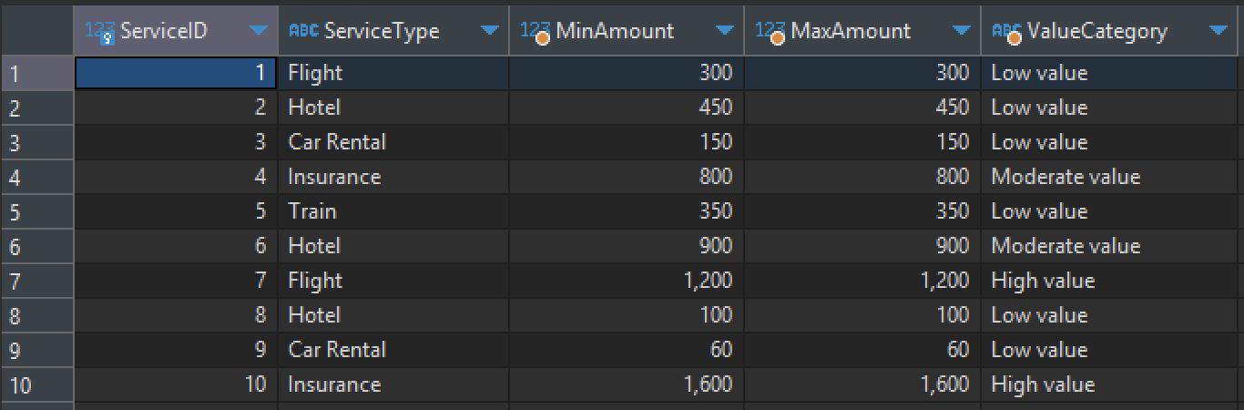
Appendix:
Report: Service Performance Indicator
Shows the minimum and maximum amounts paid for each service type and categorizes their value.
Assists in recognizing service types that are either underperforming or over performing in revenue generation.
Informs service pricing strategy and aids in adjusting focus on profitable services.
SELECT s.ServiceID, s.ServiceType,
MIN(b.AmountPaid) AS MinAmount,
MAX(b.AmountPaid) AS MaxAmount,
CASE
WHEN MAX(b.AmountPaid) > 1000 THEN 'High value'
WHEN MAX(b.AmountPaid) BETWEEN 500 AND 1000 THEN 'Moderate value'
ELSE 'Low value'
END AS ValueCategory
FROM Service s
JOIN Booking b ON s.ServiceID = b.ServiceID
GROUP BY s.ServiceID, s.ServiceType;
Page 13
Notes:
Report: Service Performance Indicators
● Description: Shows the minimum and maximum amounts paid for each service type and categorizes their value.
● Business Purpose & Benefit: Assists in recognizing service types that are either underperforming or overperforming in revenue generation.
● Use in Business Metric: Informs service pricing strategy and aids in adjusting focus on profitable services.

Slide 14
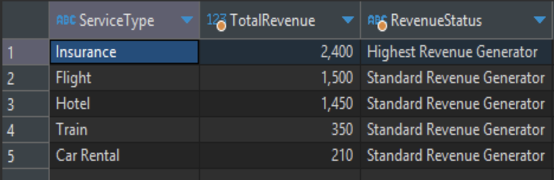
Report: Total Revenue Per Service Type
SELECT
s.ServiceType,
SUM(b.AmountPaid) AS TotalRevenue,
CASE
WHEN SUM(b.AmountPaid) >= ALL (SELECT SUM(b2.AmountPaid) FROM Booking b2 JOIN Service s2 ON b2.ServiceID = s2.ServiceID GROUP BY s2.ServiceType) THEN 'Highest Revenue Generator'
ELSE 'Standard Revenue Generator'
END AS RevenueStatus
FROM Service s
JOIN Booking b ON s.ServiceID = b.ServiceID
GROUP BY s.ServiceType
ORDER BY TotalRevenue DESC;
Total revenue generated by each service type.
Prioritizes business focus by showing the financial contribution of each service.
Acts as a crucial metric for financial planning and business health evaluation.
Page 14
Notes:
Report: Total Revenue per Service Type
● Description: Total revenue generated by each service type.
● Business Purpose & Benefit: Prioritizes business focus by showing the financial contribution of each service.
● Use in Business Metric: Acts as a crucial metric for financial planning and business health evaluation.

Slide 15
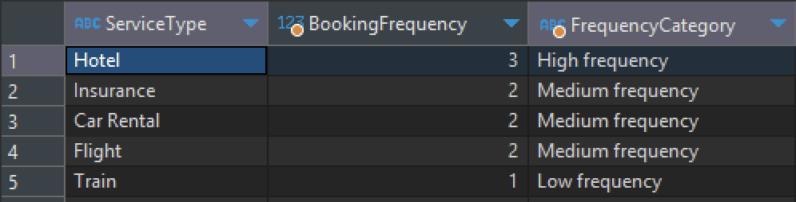
Report: Booking Frequency by Service Type
-- 5.Booking Frequency by Service Type
SELECT
S.ServiceType,
COUNT(B.BookingID) AS BookingFrequency,
CASE
WHEN COUNT(B.BookingID) >= 3 THEN 'High frequency'
WHEN COUNT(B.BookingID) = 2 THEN 'Medium frequency'
ELSE 'Low frequency'
END AS FrequencyCategory
FROM
Booking B
INNER JOIN
Service S ON B.ServiceID = S.ServiceID
-- Assuming there's a need to focus on services with at least one booking
WHERE
B.BookingDate >= '2023-01-01' -- Example condition to limit the scope, such as bookings from the current year
GROUP BY
S.ServiceType
ORDER BY
BookingFrequency DESC;
Categorizes the booking frequency for each service type into 'High', 'Medium', and 'Low' based on the number of bookings.
This report helps to identify which services are most and least frequently booked, allowing for targeted improvements and marketing efforts.
Booking frequency categories serve as an indicator of customer demand and service popularity, which can influence strategic decisions such as resource allocation, service promotion, and performance evaluation.
Notes:
Report: Booking Frequency by Service Type
● Description: Categorizes the booking frequency for each service type into 'High', 'Medium', and 'Low' based on the number of bookings.
● Business Purpose & Benefit: This report helps to identify which services are most and least frequently booked, allowing for targeted improvements and marketing efforts.
● Use in Business Metric: Booking frequency categories serve as an indicator of customer demand and service popularity, which can influence strategic decisions such as resource allocation, service promotion, and performance evaluation.

